Slide 1

SMFW
Problem Statement
Project Contributions & %
Technologies Used
Solution Architecture
PROJECT PRESENTATION
Contact Us
Introduction
BY KONDWANI LUSINJE & RABSON SAYENDA

Slide 2
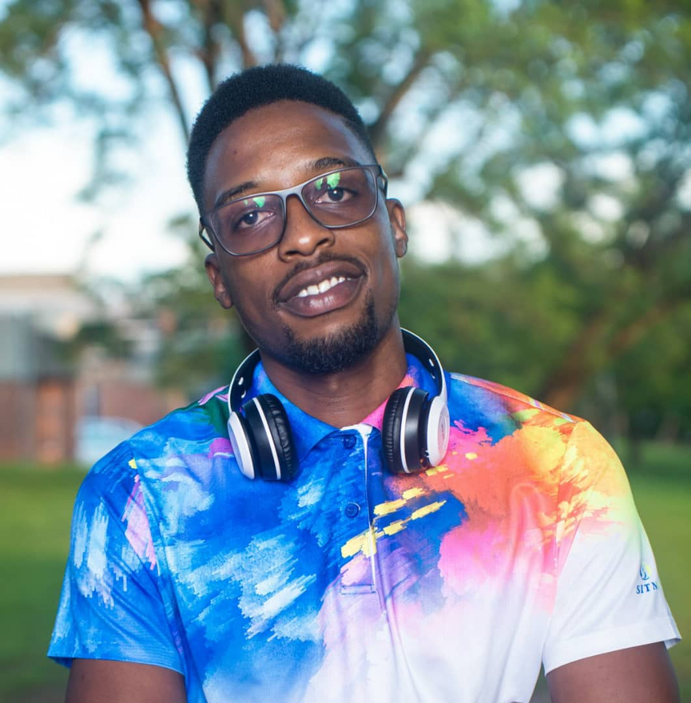
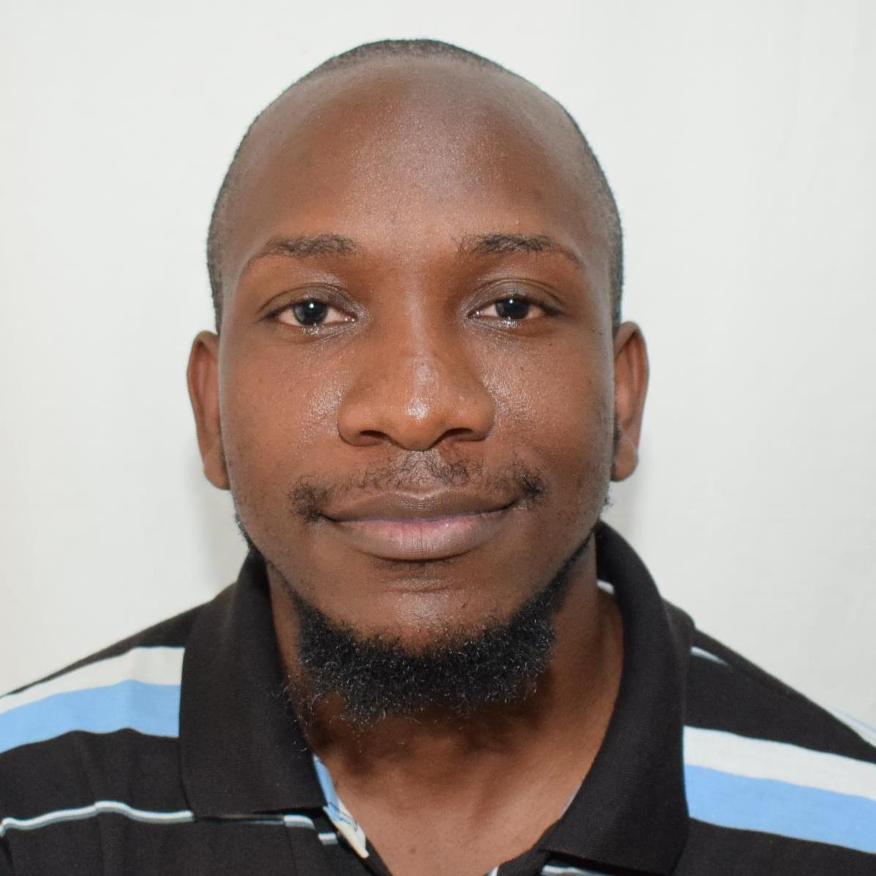
Project Contribution & %
Contact Us
Introduction
Problem Statement
Solution Architecture
Technology Used
KONDWANI LUSINJE
RABSON SAYENDA
Team Leader
Lead Developer
SUPERVISORS
DR. KONDWANI G. MUNTHALI
MISS. AKUZIKE BANDA

Slide 3



Problems
Limitations
User Needs
1
2
3
Project Presentation & %
Contact Us
Access to information
Access to markets, advisors & suppliers
Technological Literacy
Inaccessibility To Advance Gadgets
Basic Phone Literacy
Access To A Phone
Understand English or Chichewa
Introduction
Solution Architecture
Problem Statement
Technology Used

Slide 4
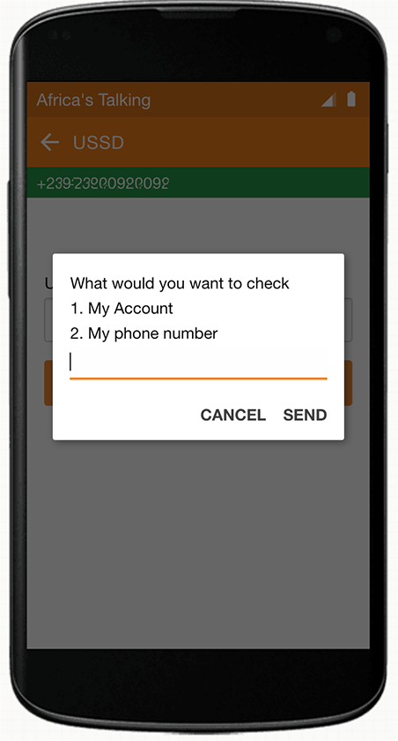


Project Presentation & %
Contact Us
Technology Used
Solution Architecture
Introduction
Problem Statement
Web App
Server
USSD
Administrator
Administrator
User
Retrieves Data
Sends Data
Produce Reports
Carryout Simple Computations
Stores Data
Retrieves Data
Sends Data

Slide 5



Problem Statement
Project Contribution & %
Introduction
Solution Architecture
Contact Us
Technology Used
Laravel
PHP
Africa’s Talking
For Web App
For The USSD App
For USSD Simulation
With Xampp Bundle (MySQL, Apache Server) and Matrix
Admin Panel
With Xampp Bundle (MySQL,
Apache Server)
Africa’s Talking API

Slide 6
KONDWANI LUSINJE CONTRIBUTIONS
RABSON SAYENDA
CONTRIBUTIONS
Web App (20%)
Web App (80%)
Dashboard Implementation
Administrator Change Password Details
Displaying Farmer Details
The rest of other functionalities
Contact Us
Technology Used
USSD App (80%)
USSD App (20%)
Solution Architecture
Problem Statement
Project Contribution & %
The rest of other functionalities
Registration system
Implementation of some menus after registration
Implementation of two languages (English and Chichewa)
Introduction
Percent of Work 90% Is Done
Web App 100 % Done
USSD App 80% Done

Slide 7
Technology Used
Contact Us
Project Contribution & %
Introduction
Solution Architecture
Problem Statement
KL
RS
+265 88 29 97 073
kondwanlusinje@gmail.com
+265 88 67 88 210
rabsonsayendajnr@gmail.com

